Slide 1
Help for Components Tutorial
Download and unzip an update version of Evolve:
  www.doc.ic.ac.uk/~amcveigh/evolve-tutorial3.zip
    Or get it from CATE
    It is compatible with the old models. If Evolve worked ok for you before, there's no need to get this version.
  The main differences are:
    Pressing delete actually deletes an object fully
    (before it just deleted the view)
    More errors are detected
    (prevents it from hanging)
    Better palette – right click to see options for creating
NB: I couldn't replicate the errors under Ubuntu with the indices
  I tested under Ubuntu at home, but it was fine
  I looks to be a remote X11 issue
  If the problem persists just use a local machine rather than a lab one
If you cannot get a model without errors, send to andrew.mcveigh@gmail.com
  I'll fix it up to have no errors (but I won't do the problem for you ;-)

Slide 2
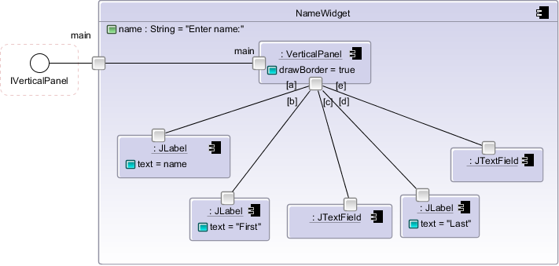
Terminology: creating a component
An attribute
Default value
Connector with an index
A port
A slot is where
We assign a value
To an attribute
A part
(is an instance of a component)
Make sure you type the colon
Then type a letter and press tab
to see the possible components
this can be an instance of.

Slide 3
Some tips...
To check the program before you run, press F8
(or use ”Checking/Check current stratum” menu)
If you get an error, look for the little red X marks
  You can also press F2 to see the browser
    Look at the ”errors” tab
Remember: undo is ctrl-Z
For the tutorial:
  Some manual recreation of components is needed
  The point was to force you to see why this was necessary, in order to satisfy the 3 programmers building on a common base
  What did we learn in the 2nd lecture that avoids the need for this? How does it avoid copying?

